Slide 1
ENV 107
Introduction to
Environmental Science
North South University

Slide 2
Energy
Energy exists freely in nature. Our universe is made from energy and it is fundamental to the existence of everything!
It exists as light, heat, sound, mass, moving objects, gravity, fuel, chemicals, and electricity. We use many of these different types of energy to enhance our lives every day.
Some of them exist infinitely (never run out, called Renewable)
The rest have finite amounts (they took millions of years to form, and will run out one day, called Non-renewable).
About three-quarters of the world’s commercial energy comes from nonrenewable fossil fuels, and the rest comes from nonrenewable nuclear fuel and renewable sources.

Slide 3
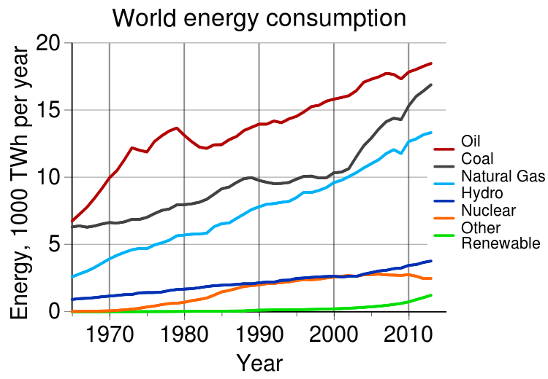
Energy Resources
Nonrenewable
Fossil fuels
Nuclear
Renewable Energy
Solar energy
Wind
Hydropower
Biomass
Geothermal

Slide 4
Non-Renewable Energy
Non-renewable energy is energy produced by burning fossil fuels such as coal.
They are non-renewable because there are finite resources of fossil fuels on the planet.
If they are continually used, one day they will run out.
Non-renewable energy is energy from fossil fuels (coal, crude oil, natural gas) and uranium.

Slide 5
Fossil Fuel
Fossil fuels are mainly made up of Carbon.
It is believed that fossil fuels were formed over 300 million years ago, when the earth was a lot different in its landscape.
It had swampy forests and very shallow seas. This time is referred to as 'Carboniferous Period'
Coal, Oil and Gas are called "fossil fuels” because they are natural combustible substances formed originally from dead plants and animals.

Slide 6
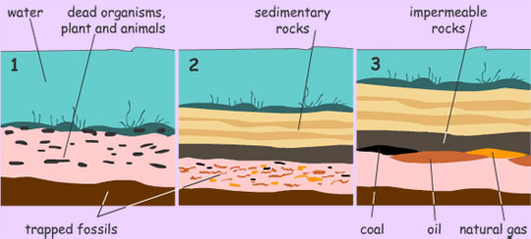
Fossil Fuel
Fossil fuels are usually found in one location as their formation is from a similar process. Let us take a look at the diagram below to see how fossil fuels are formed:

Slide 7
Fossil Fuel Formation
Millions of years ago, dead sea organisms, plants and animals settled on the ocean floor and in the porous rocks. These organic matter had stored energy in them as they used the sun's energy to prepare foods (proteins) for themselves (photosynthesis).
With time, sand, sediments and impermeable rock settled on the organic matter, trapping its' energy within the porous rocks. That formed pockets of coal, oil and natural gas.
Earth movements and rock shifts creates spaces that force to collect these energy types into well-defined areas. With the help of technology, engineers are able to drill down into the sea bed to tap the stored energy, which we commonly know as crude oil.

Slide 8
World Fuel Resources
Petroleum or Oil
Natural Gas
Coal
Power reserves
130 billion tonnes
158 billion cubic metres
950 billion tonnes
Total used in 2012
11.4 billion tonnes
12.8 billion cubic metres
185 billion tonnes
From the above table, the present world's estimated oil reserves may be used up in the next 100 years.

Slide 9
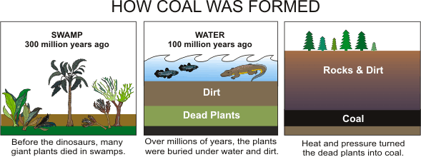
Coal
Coal is a combustible black or brownish-black sedimentary rock composed mostly of carbon and hydrocarbons.
Coal is the plants, that grew in swampy areas about 300 million years ago, died to form layers of decaying material.
Heat, pressure and the action of bacteria changed the decaying plants into coal.

Slide 10
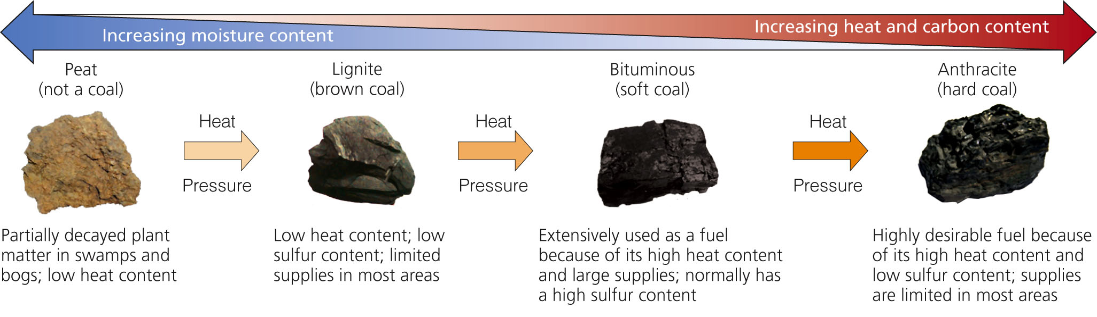
Types of Coal

Slide 11
Petroleum
Petroleum or Crude oil (a non-renewable resource) is usually found in underground areas called reservoirs.
It is liquid in nature and yellowish black in color.
They are composed mainly of hydrocarbons and organic compounds.
Crude oil can exists either deep down in the earth's surface or deep below the ocean beds. Oil drills mounted in the oceans are known as offshore dills
Saudi Arabia, USA, Russia, China and Iran are among the top crude oil producers in the world, and USA is the world's biggest consumer of crude oil, followed by China.

Slide 12
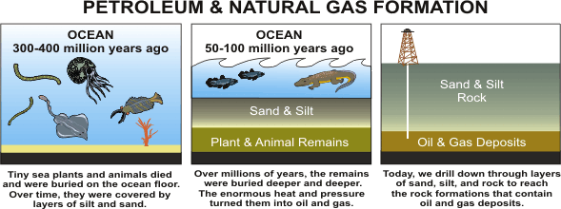
Petroleum
Petroleum was formed from small sea animals that lived millions of years ago. After they died, heat, pressure, and the action of bacteria changed the remains into oil. The oil formed was then trapped as small drops inside the pores of rocks.
Petroleum (http://www.petroleum.co.uk/)

Slide 13
Natural Gas
Natural Gas is colorless, shapeless, and odorless in its pure form. Unlike other fossil fuels, natural gas is clean burning and emits lower levels of potentially harmful byproducts into the air.
While natural gas is formed primarily of methane, it can also include ethane, propane, butane and pentane.
It is one of the gases that are formed by the same formation of fossil fuels.
Natural gas supplies about 23.8 percent of the world's energy.
Gas is extracted by drilling wells deep into the ground, through many layers or rock to reach the gas deposits.

Slide 14
Advantages and Disadvantages of Fossil Fuels

Slide 15
Fossil Fuel
Advantage
Unlike many renewable sources of energy, fossil fuels are relatively less expensive to produce. This is probably why it is in higher demand as it tend to cost less.
Disadvantage
Fossil fuels are made up mainly of carbon. When they are burned (used) they produce a lot of carbon compounds (carbon dioxide and other greenhouse gases) that hurt the environment in many ways. Air, water and land pollution are all consequences of using fossil fuels.

Slide 16
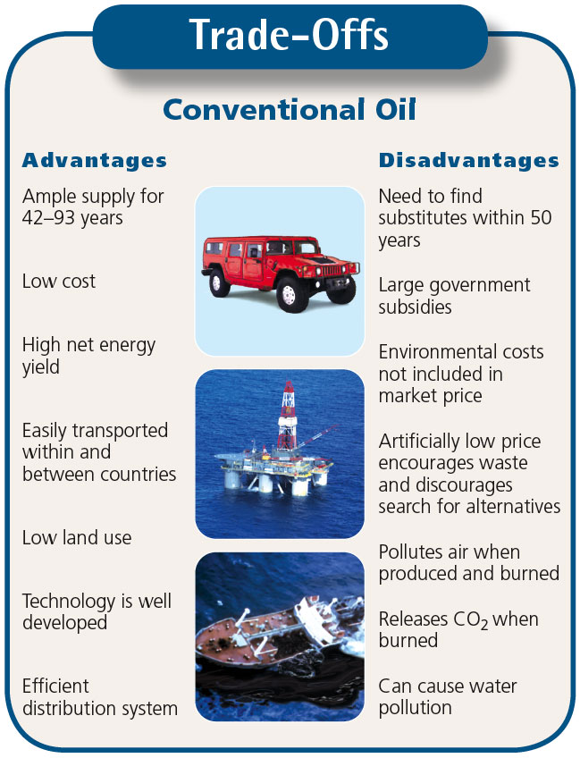

Slide 17
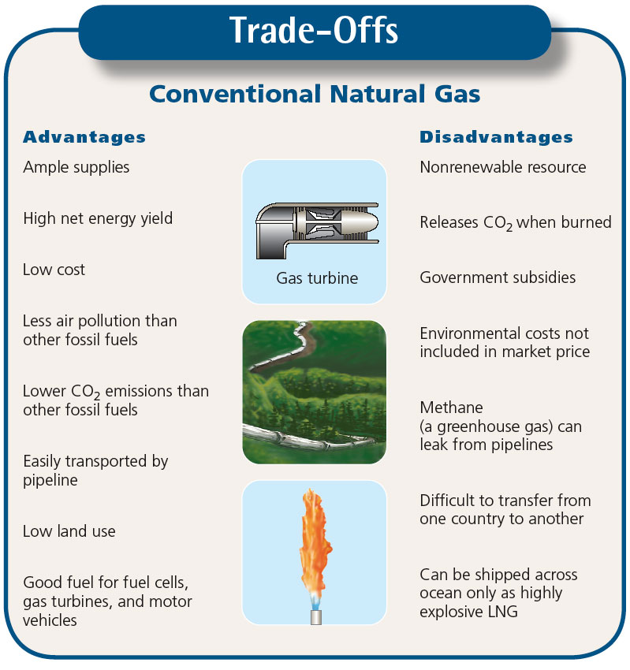

Slide 18
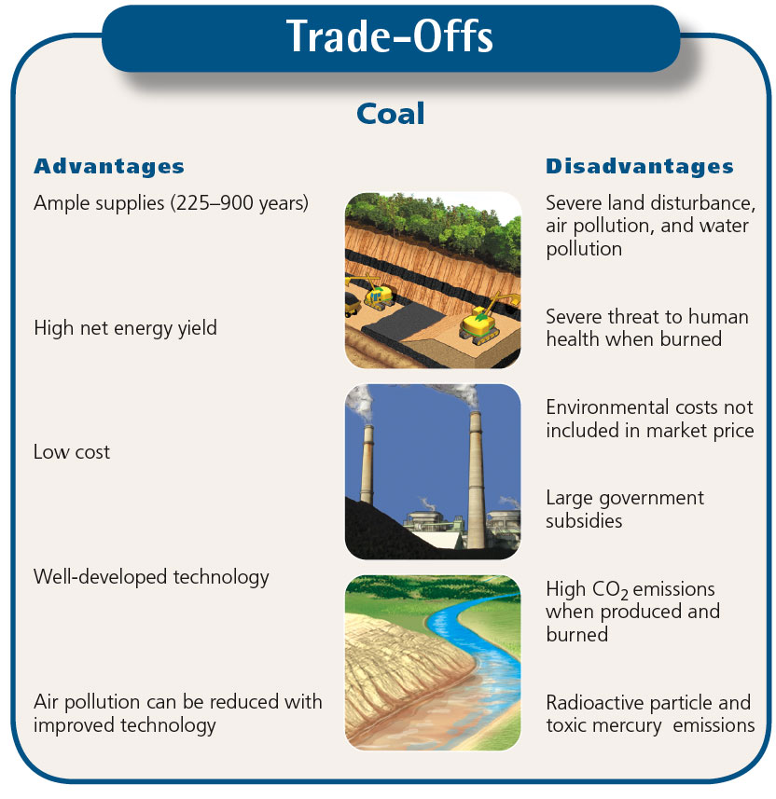

Slide 19
Nuclear Energy
Nuclear power is generated using Uranium, which is a metal mined in various parts of the world.
Nuclear power produces around 11% of the world's energy needs, and produces huge amounts of energy from small amounts of fuel with less pollution.
The nuclear power fuel cycle has a low environmental impact and a very low accident risk, but its use has been limited because of:
  high costs, a low net energy yield, long-lived radioactive wastes, vulnerability to sabotage, and the potential for spreading nuclear weapons.

Slide 20
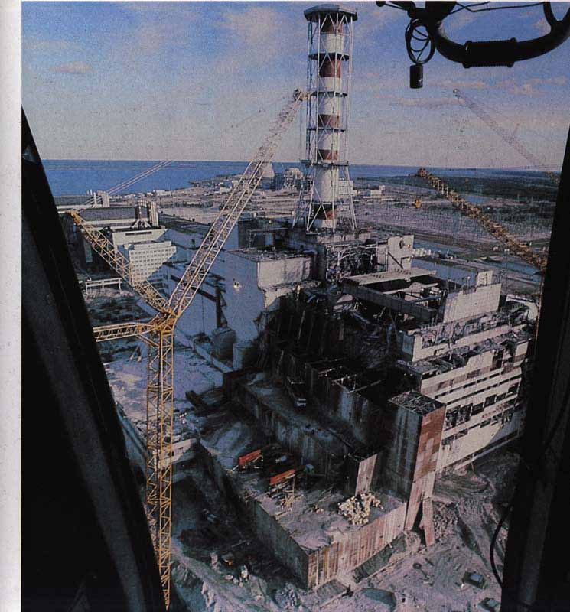


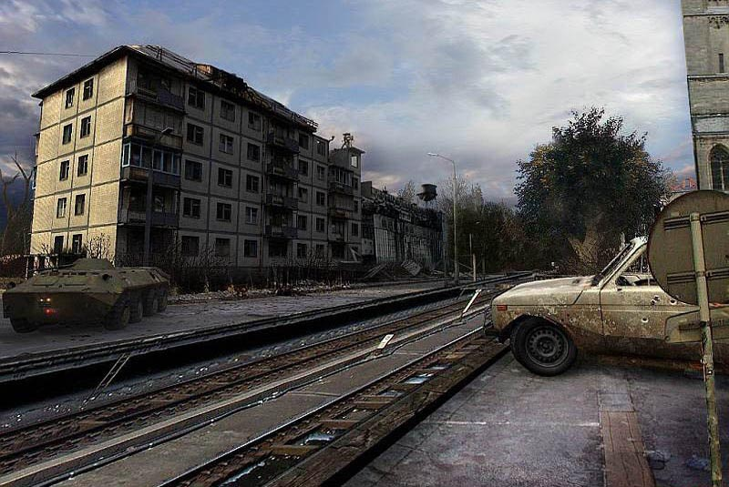

Slide 21
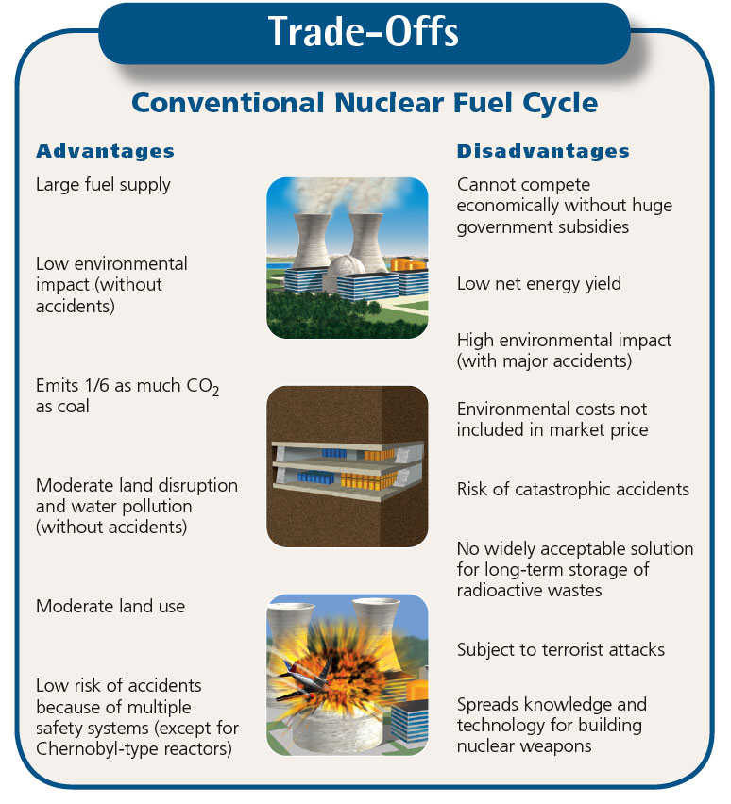

Slide 22
Nuclear Energy
Produces very dangerous waste in the form of radio-active waste, even though the amount of waste is small (about 3% of the plants waste). These are usually disposed of very deep underground where geological conditions are stable and far from human or environmental exposure.
In 2011, a tsunami struck Japan and caused problems with its nuclear power plant in Fukushima. After that tsunami, there has been a couple of leakages of highly radioactive water from the plants storage tanks into its environment. Radioactive materials are very dangerous to humans and the environment.
There are laws that check that countries with unclear plants comply with safety rules and also do not misuse their plants for developing nuclear weapons.

Slide 23
Effects of Non-Renewable Resources
Sulfur dioxide (SO₂) which causes acid rain and harms plants and animals. Acidic water can drain from mines, polluting natural ecosystems
Nitrogen oxides (NOx), which contribute to smog
Particulate matter (PM) which contributes to asthma and chronic bronchitis in humans
Carbon monoxide(CO), Lead and various air toxins which may be emitted when some types of petroleum are burned, all of which come with significant human health hazards
Exploring and drilling for these products disturbs natural habitats on land and in the sea
Many humans die in the process of mining every year around the world

Slide 24
Effects of Non-Renewable Resources
Mercury is released when coal is burned – linked to neurological and developmental problems in humans
Mountaintop removal coal mining involves blowing the tops off of entire mountains to get at the coal deposits
Fly ash and bottom ash are two byproducts produced when burning coal, adding to air pollution
Mining uranium and building nuclear power plants require large amounts of energy, leading some to question whether the energy inputs are worth the energy outputs.
The radioactive nuclear waste created in nuclear power plants remains dangerous to human and environmental health for thousands of years
These power plants can experience major failures resulting in catastrophic meltdowns like Chernobyl

Slide 25
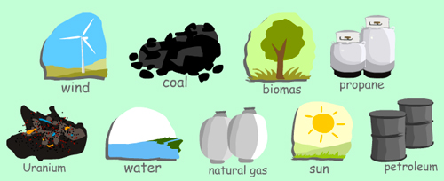
When can energy be called 'Renewable'?
When its source cannot run out (like the sun) or can easily be replaced (like wood, as we can plant trees to use for energy)
When their sources are carbon neutral. This means they do not produce Carbon compounds (such as other greenhouse gases).
When they do not pollute the environment (air, land or water)

Slide 26
Benefits of Shifting to Renewable Energy Resources
More decentralized, less vulnerable
Improve national security
Reduce air pollution
Create jobs
Save money
Renewable energy is handicapped by
  Unbalanced, intermittent subsidies
  Inaccurate pricing

Slide 27
Solar Energy for High-Temperature Heat and Electricity
Solar thermal systems
Used to heat water or other fluids, and can also power solar cooling systems.
Solar thermal plant
Solar cookers
Use free heat from the sun to warm domestic hot water or cooking
Photovoltaic (solar) cells
A device converting solar radiation into electricity

Slide 28
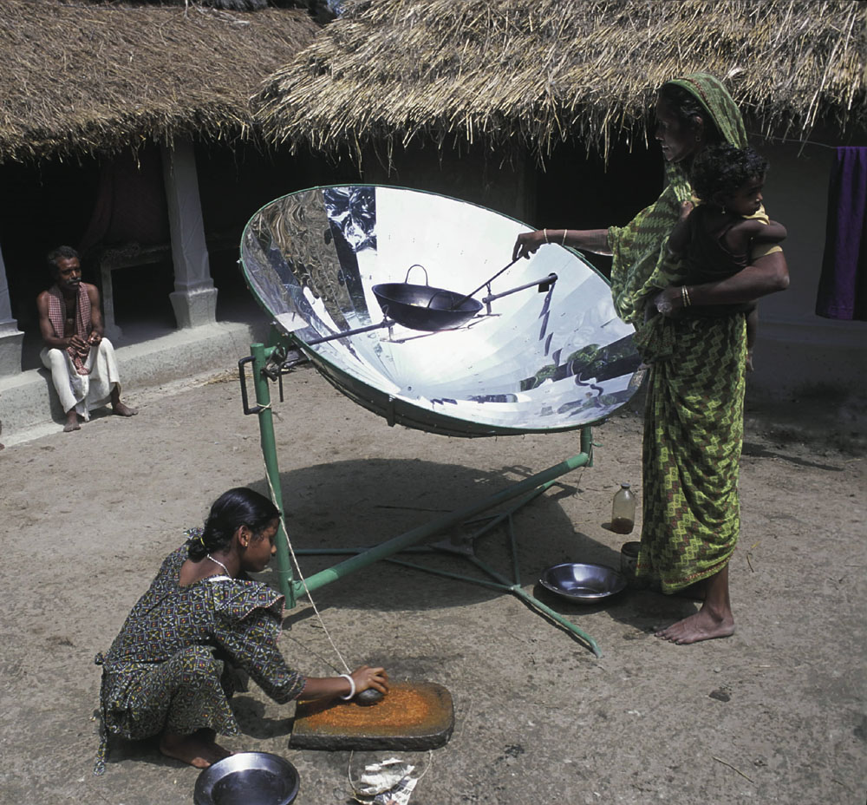

Slide 29
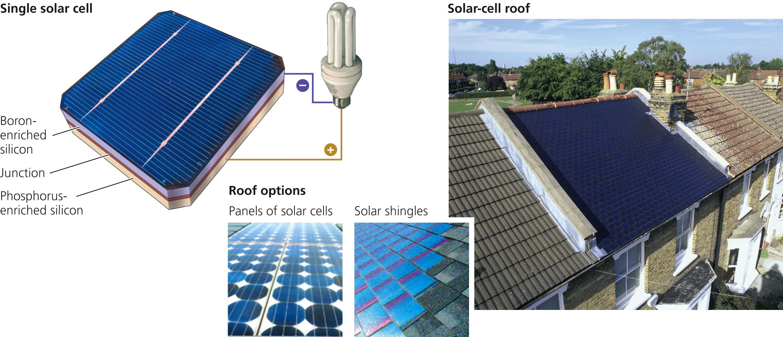
Photovoltaic (PV) or Solar Cells
Photovoltaic (PV) or solar cells can provide electricity for a house or building using solar cell roof shingles, as shown in this house in Richmond Surrey, England. Solar-cell roof systems that look like a metal roof are also available. In addition, new thin-film solar cells can be applied to windows and outside walls.

Slide 30
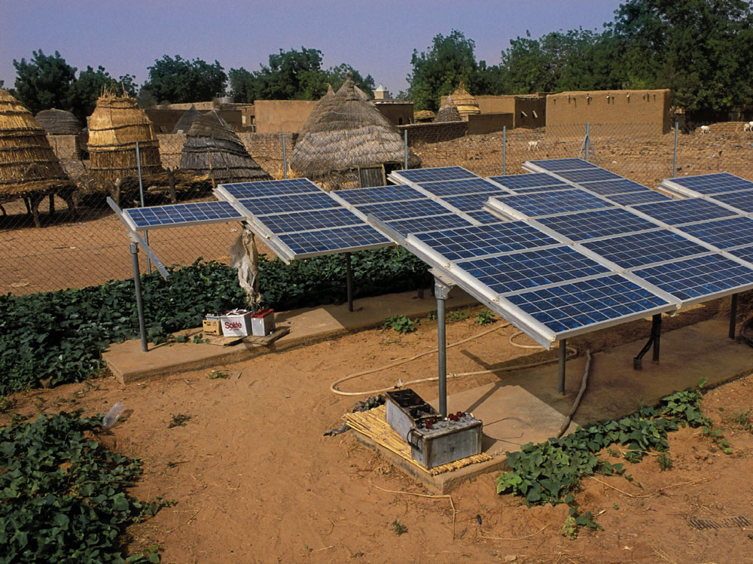

Slide 31
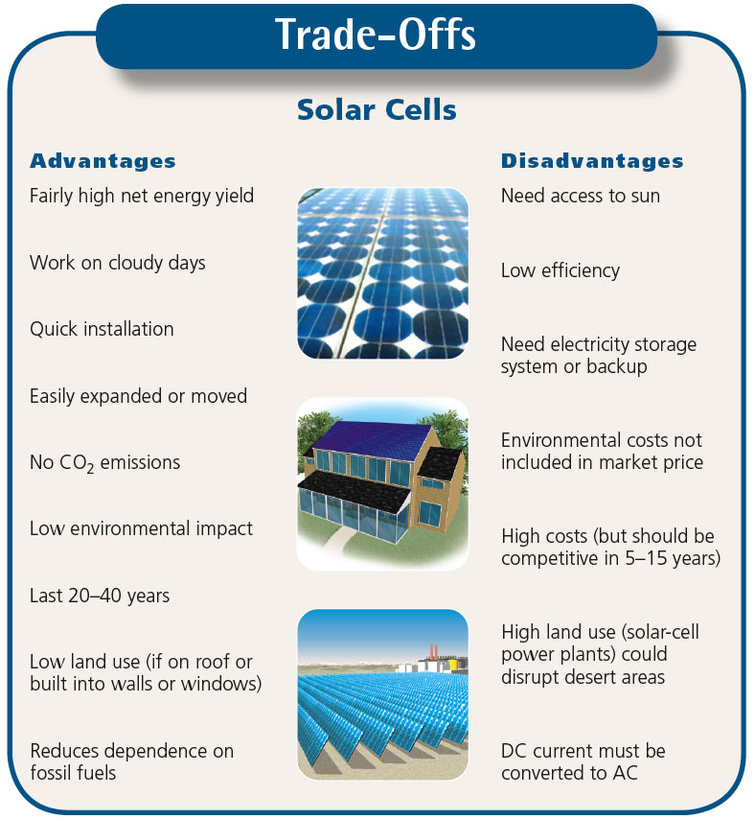

Slide 32
Hydropower
We have used running water as an energy source for thousands of years, mainly to grind corn.
The first use of water to generate electricity was in 1882 on the Fox river, in the USA, which produced enough power to light two paper mills and a house.
Nowadays there are many hydro-electric power stations, providing around 20% of the world's electricity.
The name comes from "hydro", the Greek word for water.

Slide 33
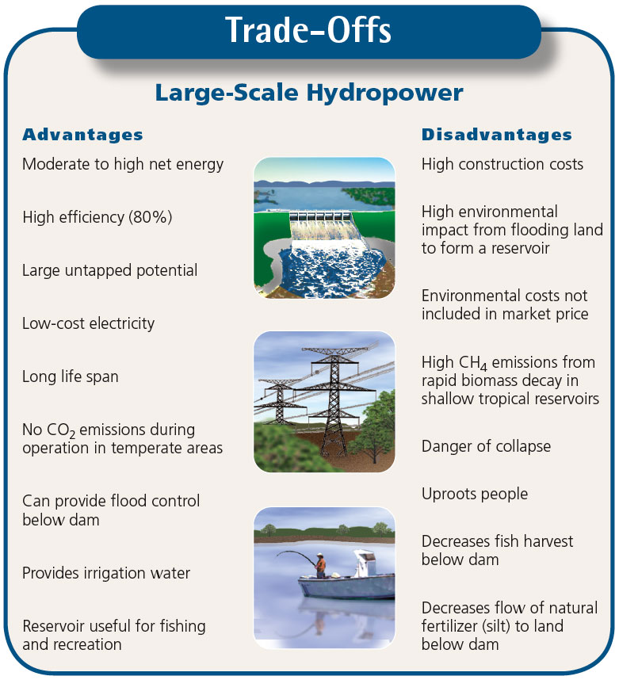

Slide 34
Producing Electricity from Wind
Indirect form of solar energy
World’s second fastest-growing source of energy
Vast potential
  Land
  Offshore

Slide 35
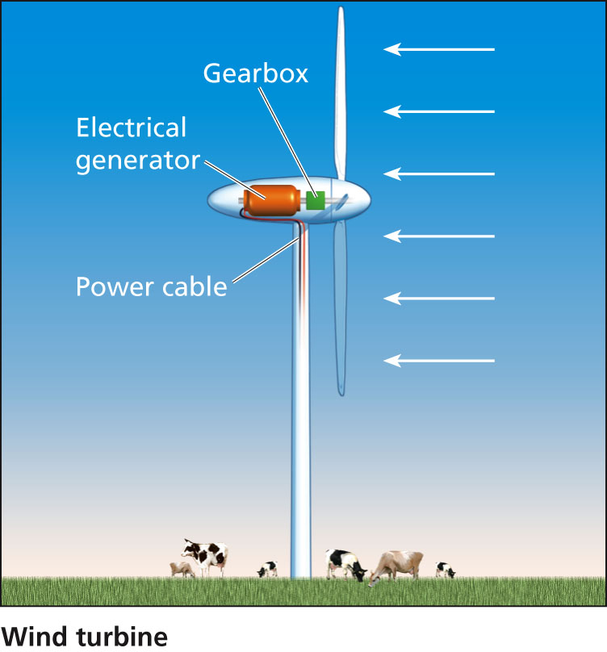

Slide 36
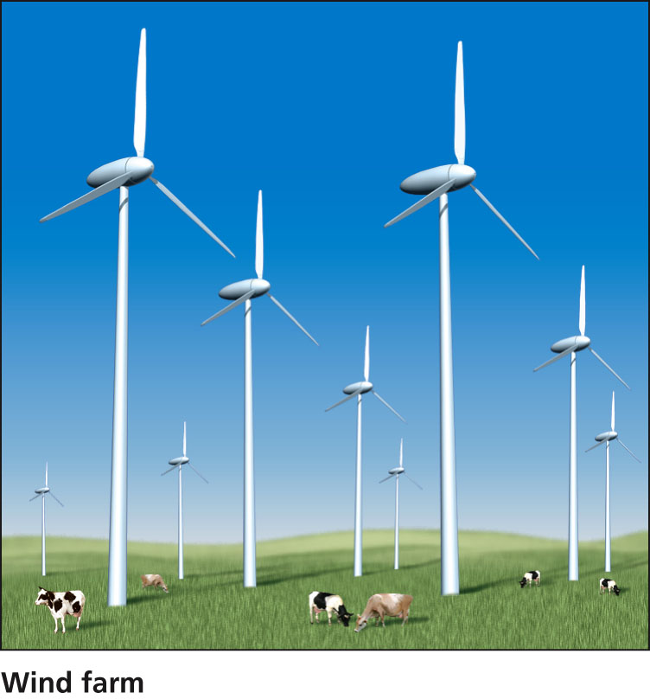

Slide 37
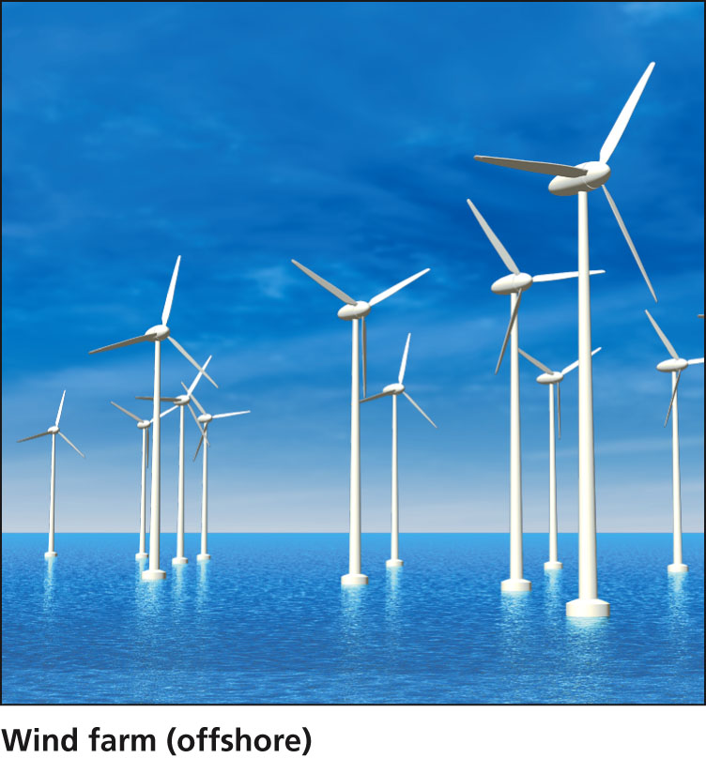

Slide 38
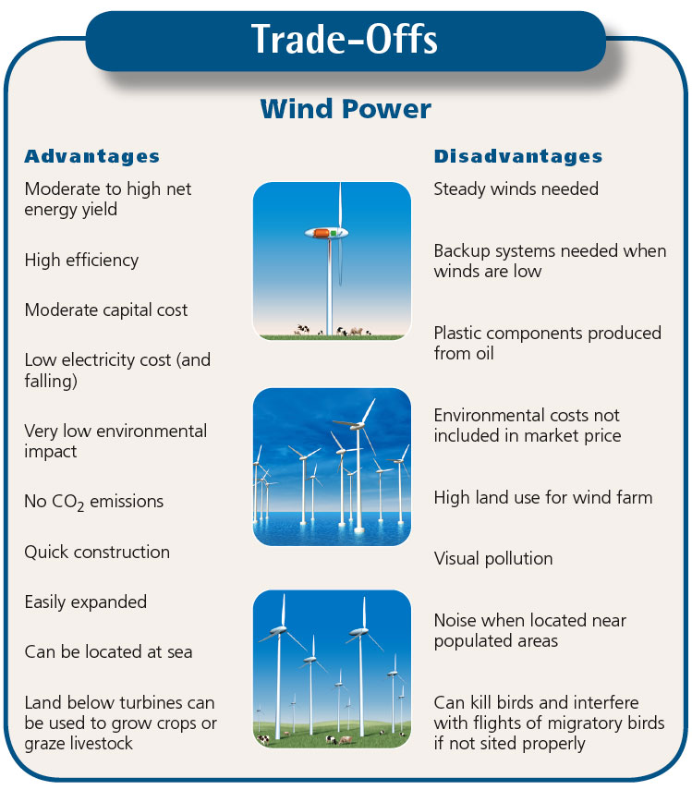

Slide 39
Geothermal
The centre of the Earth is around 6000 degress Celsius - hot enough to melt rock. Even a few kilometres down, the temperature can be over 250 degrees Celsius.
In general, the temperature rises one degree Celsius for every 36 metres you go down.
Geothermal energy has been used for thousands of years in some countries for cooking and heating.
The name "geothermal" comes from two Greek words: "geo" means "Earth" and "thermal" means "heat".

Slide 40
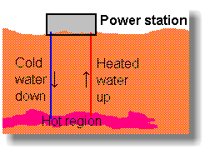
Geothermal
Hot rocks underground heat water to produce steam.
We drill holes down to the hot region, steam comes up, is purified and used to drive turbines, which drive electric generators.

Slide 41
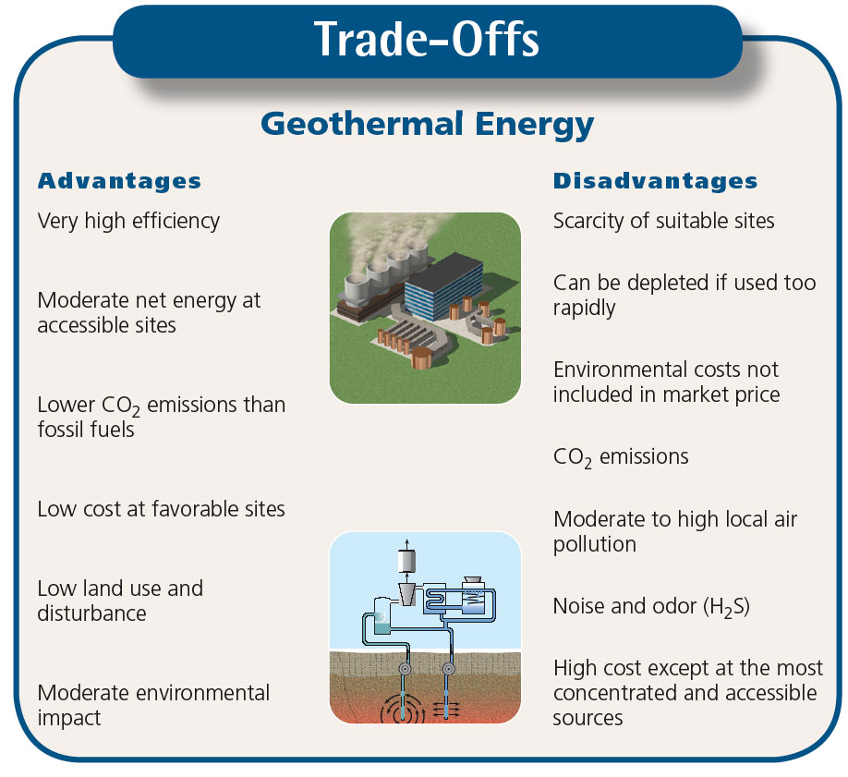

Slide 42
Why Saving Energy is Important
Energy efficiency saves you money.
Energy efficiency improves the economy.
Energy efficiency is good for the environment.
Energy efficiency improves national security.
Energy efficiency enhances quality of life.

Slide 43
Saving Energy
Saving energy can be achieved in a couple of ways:
1.Energy conservation: This is the practice that results in less energy being used
2.Energy Efficiency: This is the use of manufacturing techniques and technology to produce things that use less energy for the same result
3.Recycling: This involves the use of waste or old materials to make new ones

Slide 44
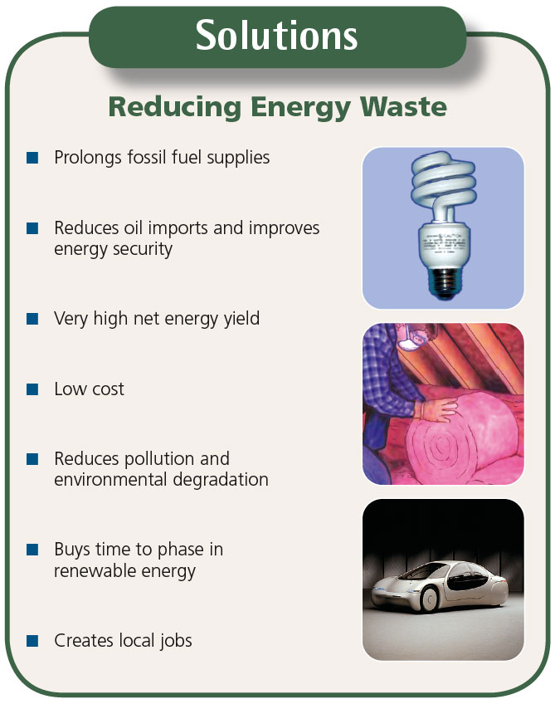

Slide 45
Why Are We Still Wasting So
Much Energy?
Energy costs relatively little
Lack of government support and economic incentives
Inadequate building codes
Inadequate appliance standards
Lack of information about saving energy

